Slide 1
ANALYSIS ON ACCIDENTS IN INDIA (2001-2014)
Done by:
TANOUZ.DOGIPARTHI-9919004067
MENTOR: R.RAJA SUBRAMANIAN
COURSE : PYTHON (CSE18R254)

Slide 2
My team
ESWAR-9919004061
PARAMESH-9919004096
PRANEETH-9919004047
My GITHUB link
https://github.com/Tanouzdogiparthi/Analysis-on-road-accidents-in-india.git
Font I used is Agency FB

Slide 3
ABSTRACT
This is an analysis accidents in INDIA b/w 2001 and 2014 on Road in different states in INDIA
Every day we are hearing about accidents in every even village that means accidents are increasing rapidly every year so .I decided to do analysis on it
TARGET: To reducing accidents in India
Used jupyter notebook to do analysis

Slide 4
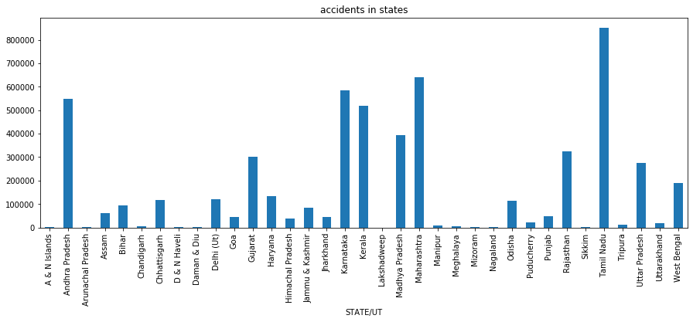
STATE WISE ANALYSIS ON THE NO OF ACCIDENTS IN INDIA(2001-2014)
This bar graph represents the total no of accidents occurred in INDIA between 2001-2014
According to this BAR graph we can analyze the difference between states and their accident number
From this we can easily sat that most no of accidents took place in TAMILNADU over 8lakh accidents took in 14 years

Slide 5
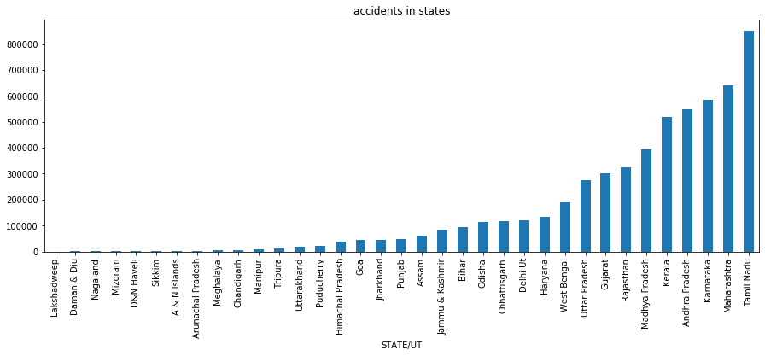
ANALYSIS BY SORTED OF TOTAL NO’ OF ACCIDENTS IN STATES
It is also same graph but with sorted values total no of accidents occurred in different states in india
From this we can say that most of the Union Territories have very less no of accidents and the south india stood on top places as the 5 states occupied top 5 places

Slide 6
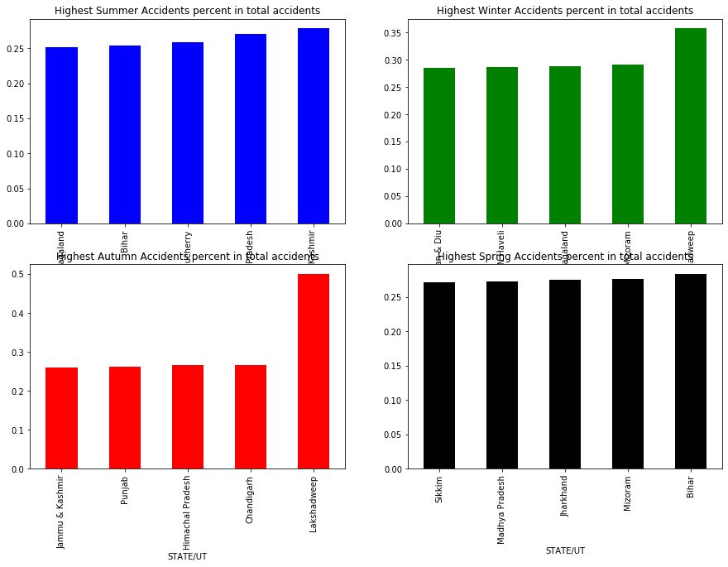
ANALYSIS OF TOP 5 %SEASONAL ACCIDENTS
This is the analysis of highest accidents occurred in different seasons
Here it no depend on total no of accidents in that season it is of the percentage of accidents that season
EXAMPLE: even the state has less total accidents but more on summer season then it contribution is high in summer and it takes high place

Slide 7
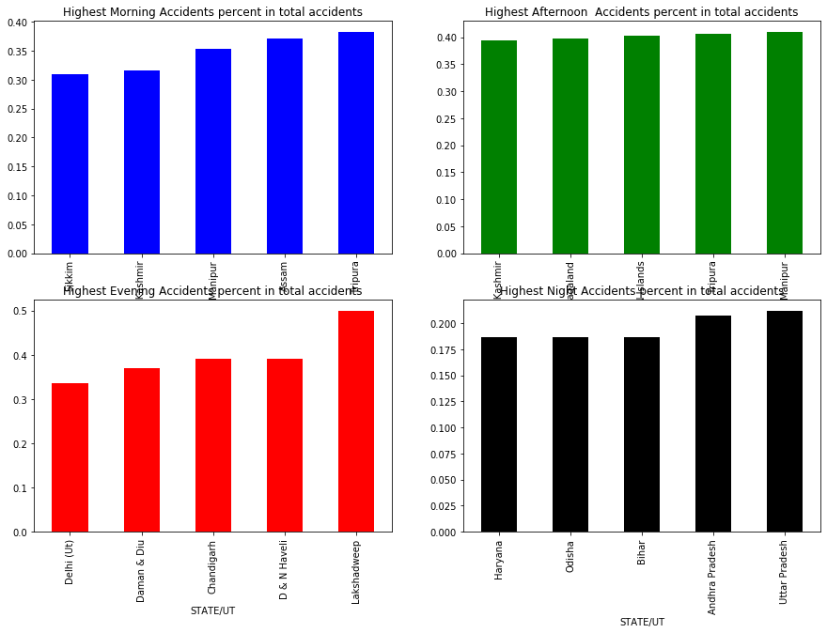
ANALYSIS OF TOP 5 %DAILY ACCIDENTS
It is also based on same analysis but here it is with daily timings divided as morning,afternoon,evening,night(it is in reverse order)
Through this analysis we can say that afternoon accidents are almost same in all states

Slide 8
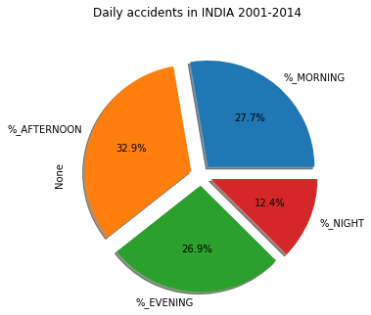
ANALYSIS OF DAILY DISTURBUTION OF TOTAL ACCIDENTS IN INDIA 2001-2014
This is a complete daily analysis of total accidents occurred in INDIA (2001-2014)
Here we can see that the majority of accidents are in afternoon time and next evening and morning are having same percentage and at night times it is less
In my analysis
Morning--: 6-9,9-12
Afternoon--: 12-15,15-18
Evening--: 18-21,21-24
Night--: 0-3,3-6

Slide 9
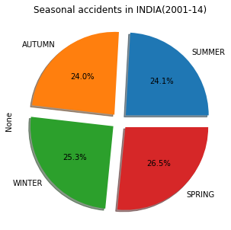
ANALYSIS OF SEASONAL DISTURBUTION OF TOTAL ACCIDENTS IN INDIA 2001-2014
This is a complete daily analysis of total accidents occurred in INDIA (2001-2014)
Here we can see that the majority of accidents are in spring season and next winter and autumn and summer having same percentage and less accidents comparing to remaining
In my analysis

Slide 10
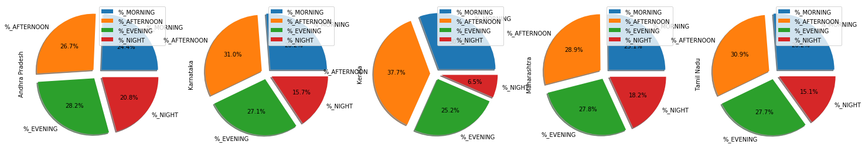
ANALYSIS OF DAILY DISTURBUTION OF HIGHEST 5 TOTAL ACCIDENTS STATES IN INDIA 2001-2014
Here the set of pie charts are the daily analysis of accidents of top 5 states in total no of accidents
Here all of the states are having highest accidents in afternoon of a day
All of the states are having same distribution in percentage wise of daily

Slide 11
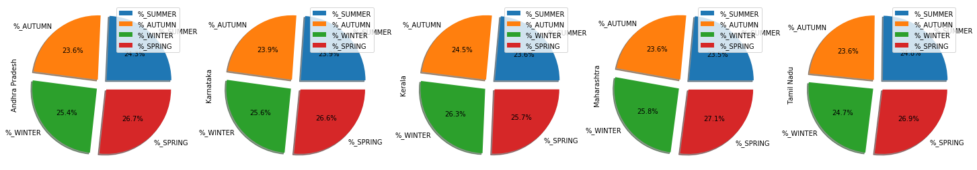
ANALYSIS OF SEASONAL DISTURBUTION OF HIGHEST 5 TOTAL ACCIDENTS STATES IN INDIA 2001-2014
Here the set of pie charts are the sesonal analysis of accidents of top 5 states in total no of accidents
Here all of the states are having highest accidents in winter season
All of the states are having same distribution in percentage wise of all seasons

Slide 12
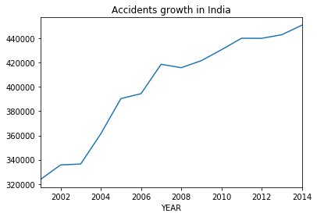
ANALYSIS ON GROWTH IN TOTAL NO OF ACCIDENTS IN INDIA ON ROAD 2001-2014
Here we can see a lot difference is there b/w 2001 and 2014
Every year the number of accidents are increasing
Except in 2008 there is a slight decrease in no of accidents from 2007 to 2008
Other than that accidents are being increasing every year

Slide 13
PYTHON AND PANDAS PACKAGES USED
Here I used jupyter notebook for doing the project on data analysis using python as spyder is no working in my laptop
While doing this project in which I used PANDAS and MATPLOTLIB
I came across some new methods (FUNCTIONS) in which
.HEAD()----used to return the top 5 rows of a dataset
.TAIL()----used to return the last 5 rows of a dataset
.UNIQUE()—It is used to return an array of unique values of a column
.REPLACE ()--is used to replace the value of an item with other value given

Slide 14
AXIS=1 --represents columns and used to access columns of a dataset
AXIS=0--represents row and used to access rows of a dataset
LOC() –--It is a method used to access a group of rows and columns by index labels
.SUM()----It is a method used to return the sum of the values foe the requested axis or index ,then it will add all the values of that dadaset and returns
.T (or) .TRANSPOSE()----it is a function that transpose index and columns of dataset and also change the values of columns to rows ,rows to columns

Slide 15
CONCLUSION:
Based on my analysis accidents need to be decreased in INDIA as accidents are rapidly increasing
Awareness need to be brought on this and in accident prone zones cautions must be kept
Especially in SOUTH INDIA

Slide 16
MY FUTURE PLANS
AT PRESENT I HAVE DONE WITH A SIMPLE DATA SET, IN FUTURE I’II DO MORE ANALYSIS WITH DATASET HAVING AGEGROUP AND MANY MORE
AND ALSO I’M BEING VERY HAPPY IN DOING THIS LEARNING NEW THINGS ,FROM THIS I GOT SOME KNOWLEDGE ON USING PANDAS AND MATPLOTLIB
IN FUTURE I’LL DO THESE IN SPYDER LAB ALSO
WITH THIS I WON’T STOP I’LL DO MORE LIKE THIS FOR SAKE OF MY KNOWLEDGE

Slide 17
I’LL TRY TO KEEPON LEARNING MORE AND DOING THOSE
I TRY TO DO SOME MORE COMPLEX CHARTS AND DATASTES
THANK YOU TO MANJETH SIR FOR GIVING ME THIS OPPORTUNITY
THANKS TO RAJA SIR FOR ENCOURAGING ME AND SUPORTING ME AND GIVING SUGGESTIONS TO DO THIS PROJECT

Slide 18
REFERENCE:
KAGGLE for Datasets
Geeksforgeeks ,python official website ,quora, w3resourses e.t.c..
I used above websites for my reference in doing project

